Slide 1

8th Semester
Project Presentation
on
Image Based Cattle Measurement and Trait Estimation System
Presented by
Sriya Padhy ( Regd. No. : 22UG010750 )
Tina Begum ( Regd. No. : 22UG010911 )
Under the guidance of
Mr. V. S. K. Chaitanya
Assistant Professor, Department of CSE, GIET University
Gandhi Institute of Engineering and Technology University
January 2026

Slide 2
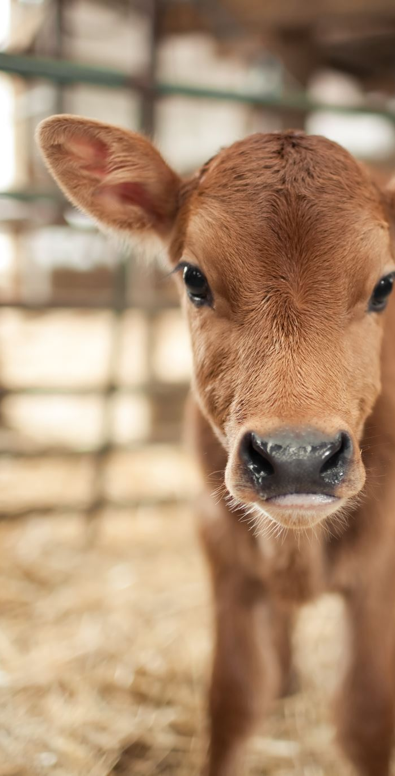
Image Based Cattle Measurement and Trait Estimation System
Theme: Agriculture, FoodTech & Rural Development Software
AI-driven, objective livestock assessment using image-based measurements.

Slide 3
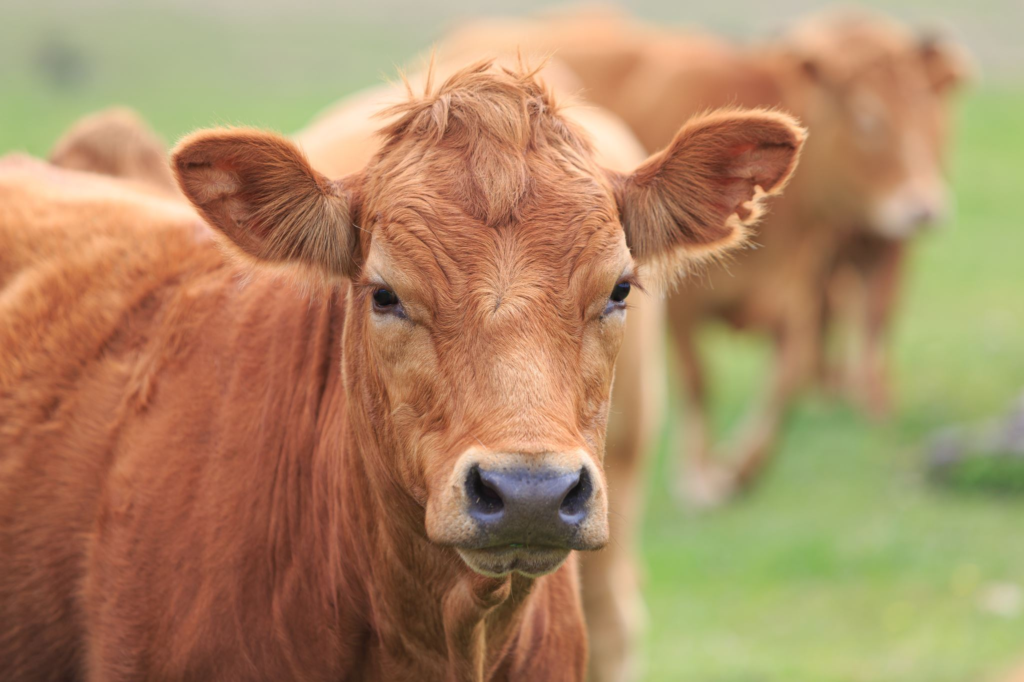
Problem Statement
Livestock classification relies on manual visual judgment
Biased, inconsistent, and non-standardized outcomes
Unfair pricing and poor breeding decisions
Data gaps in government systems
Core gap: No scalable, objective image-based system for cattle and buffalo classification

Slide 4
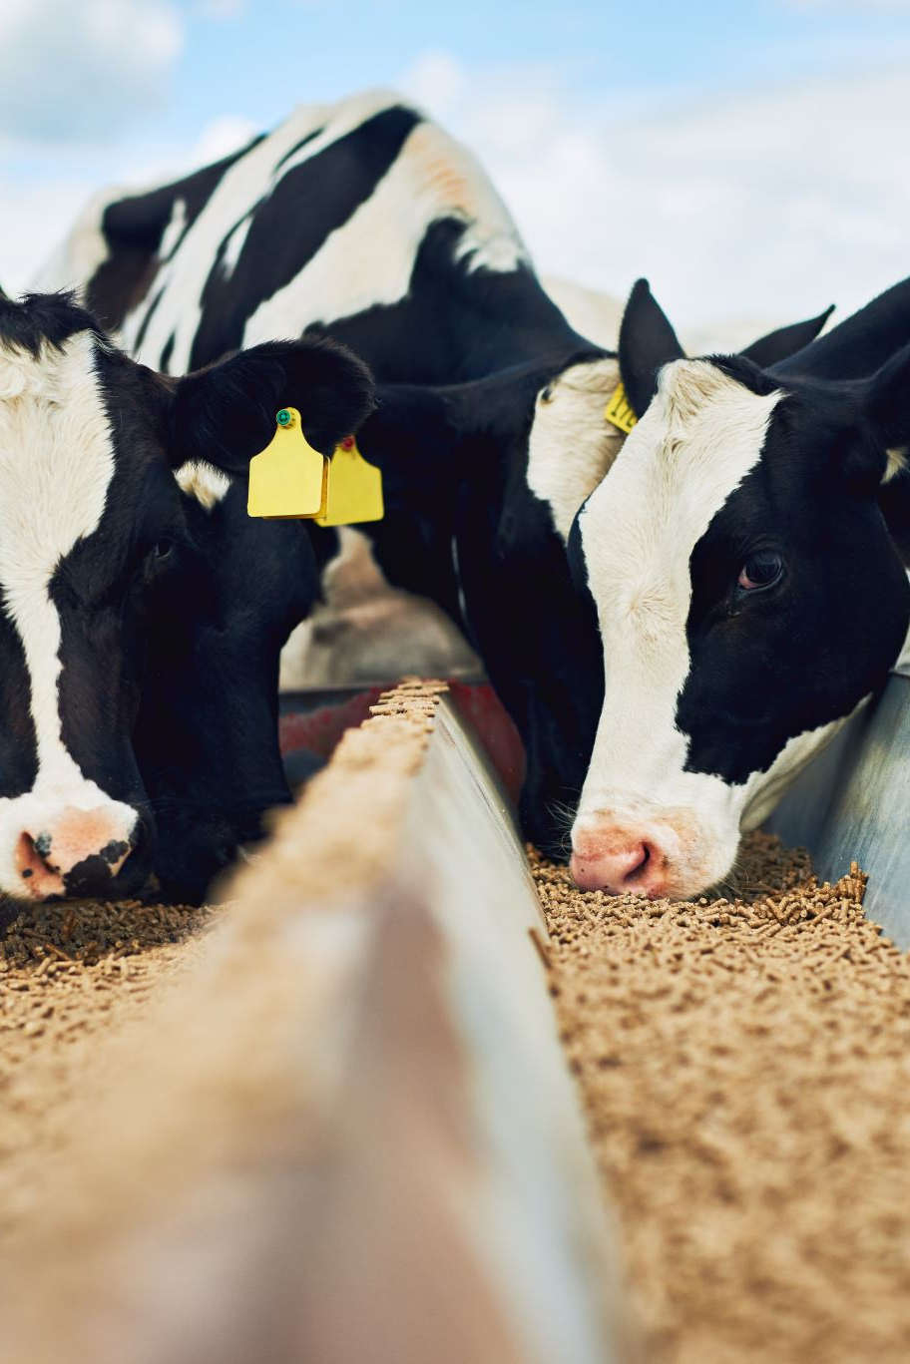
Idea
AI-based Image Classification and Measurement System for Cattle focus on :
Non-contact
Automated
Standardized
App-ready

Slide 5
Proposed Solution – Overview
User uploads animal image
Animal detection and landmark identification
Physical measurements computed
Scores standardized and stored
Structured output

Slide 6
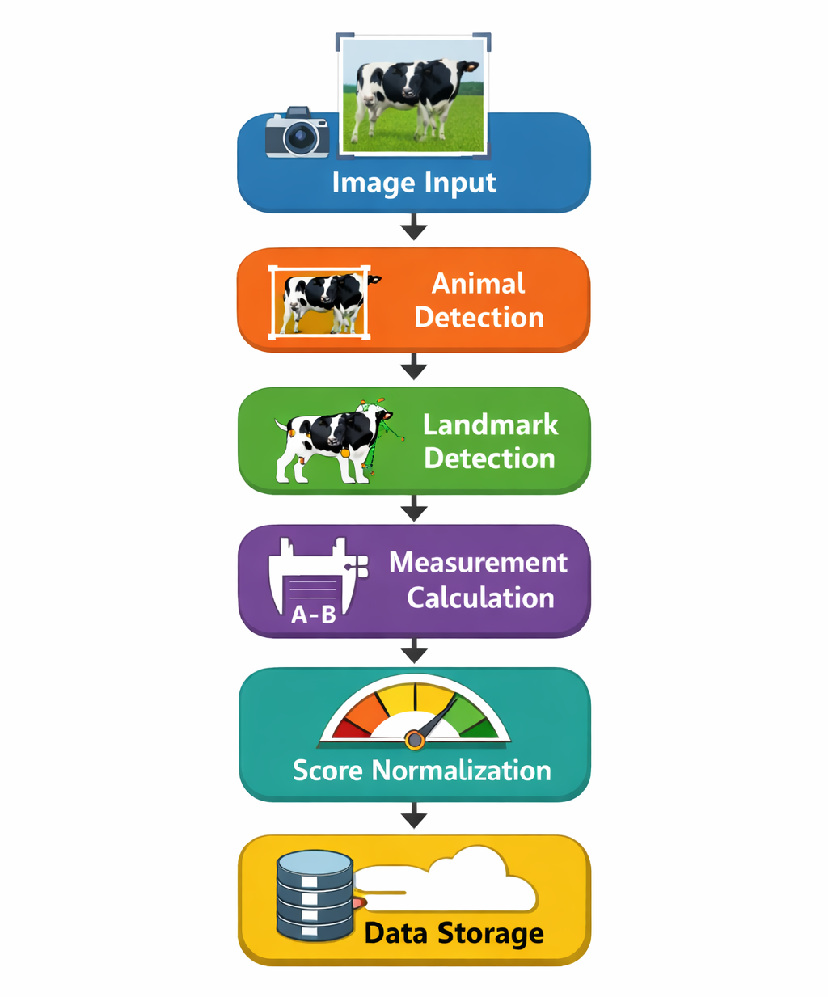
System Architecture
Image input
Animal detection
Landmark / keypoint detection
Measurement calculation
Score normalization and storage
Goal: Remove human subjectivity using AI-driven metrics

Slide 7
Key Measurements Extracted
Body length
Rump angle
Shoulder–rump alignment
Structural proportions
Direct correlation with health, milk yield, and breed quality

Slide 8
Technical Approach
Image-based animal detection
Pose / keypoint identification
Measurement computation from landmarks
Standardized scoring mechanism
Accuracy prioritized over visual aesthetics

Slide 9
Technologies Used
Python
CNN-based deep learning models
YOLO-based object detection
Image preprocessing
and
data augmentation
Keypoint / pose estimation models

Slide 10
Feasibility & Viability
Smartphone cameras are sufficient
Lightweight inference models possible
No physical sensors required
Low per-use operational cost
Scales across rural regions

Slide 11
Challenges Identified
Dataset scarcity
Complex pose variations
Occlusion
and background noise
Lighting
and
angle inconsistencies

Slide 12
Solutions Applied
Custom dataset creation
Manual landmark annotation
Domain
specific
fine-tuning
Aggressive data augmentation

Slide 13
Impact & Benefits
Fair pricing and easier livestock evaluation for farmers
Better livestock selection for dairy industry
Data-driven welfare monitoring for government and NGOs

Slide 14
Risks
Learning curve for farmers
Smartphone and internet dependency
Initial setup and training costs
Adoption is the real bottleneck, not the model

Slide 15
Overall Benefits
Transparent livestock evaluation
Improved rural livelihoods
Higher productivity and profitability
Sustainable farming practices

Slide 16
Research & References
Automated Measurement of Cattle Dimensions Using Keypoint Detection + Depth Imaging
YOLOv8-Pose with <7% average error (MDPI Animals Journal)
T-LEAP: Occlusion-Robust Pose Estimation of Walking Cows (arXiv)

Slide 17
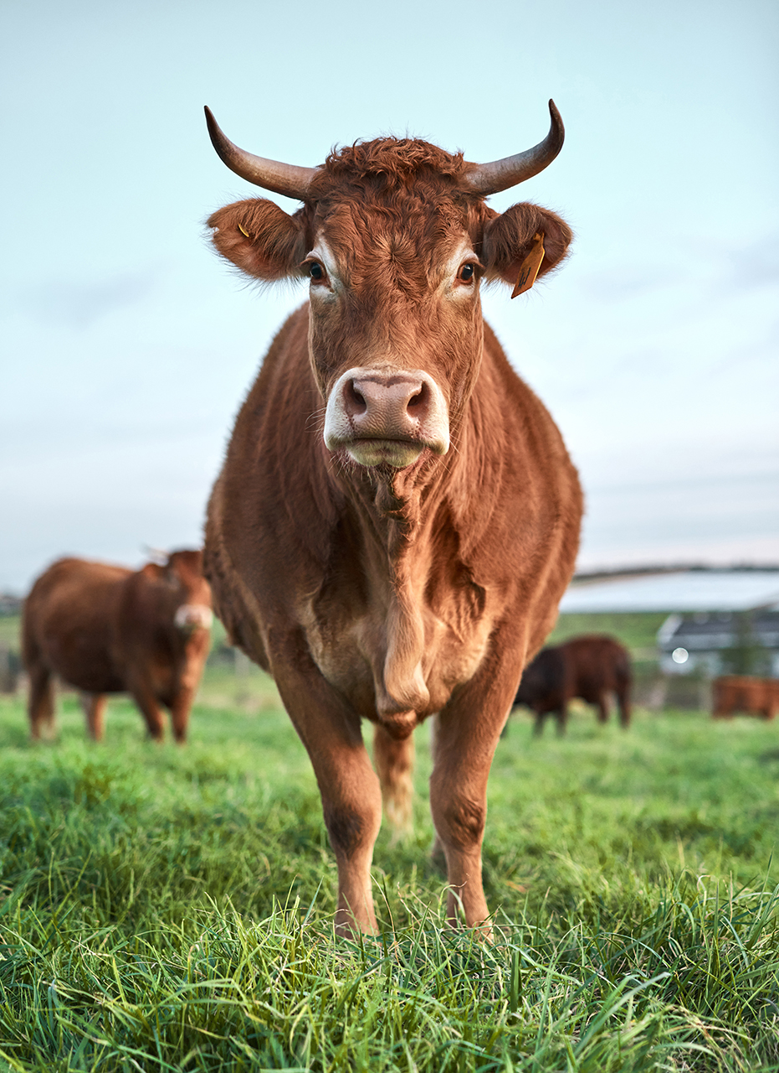
Conclusion
AI can remove bias from livestock assessment
Image-based systems are practical in rural India
Standardization without physical contact is achievable
Next step: Pilot deployment and real-world validation

